Slide 1
Data Understanding

Slide 2
Typical Data Science Cycle
Data Collection
Business Insights & Understanding
Data Understanding
Model Building & Evaluation
Data Pre-Processing

Slide 3
What is Data Understanding ?
Data understanding is a step in data science project where we :
Assess availability of data (Present and Future)
Assess variety of data sets
Assess relevance of data sets
Assess quantity of data sets
Assess Bias of data sets
Availability
Data
Relevance
Quantity
Ethics
Variety

Slide 4
Need of data understanding
Data understanding helps to answer following questions :
Do I have all the attributes required to develop model ?
Is my data bias towards any particular segment ?
Do I have sufficient quantity of data ?
Will my data be available after few months?
Can I pull out all my data sets easily?

Slide 5
Need of data understanding
Case Study Example

Slide 6
Need of data understanding
1. Availability :
All the attributes should must be present once I deploy my model back into production system.
Some of the attributes might not be available due to source failure or replacement

Slide 7
Need of data understanding
2. Variety
A variety of data helps to capture a good number of attributes and provides a good
predictive strength to machine learning model.
e.g. for a loan campaign ml model it is good to have a good variety of customer
attributes including demography , financials , social , organizational relationship ,
risk attributes , campaign responsiveness etc.

Slide 8
Need of data understanding
3. Relevance
“is there a connection between data points and what we wish to predict”
Our data should be relevant to business problem
e.g. To predict whether a person will response on education facebook advertisement ,
collecting customer’s height will not add much sense.
Data understanding brings insight about relevance of data and direct us
to need of further data exploration
If data table is related to attributes which I desire, I will go ahead for import of data and EDA

Slide 9
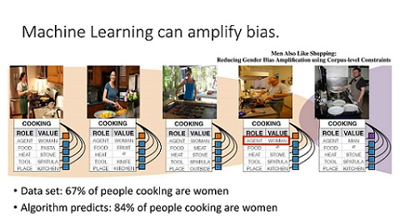
Need of data understanding
4. Ethics
Data should cover all possible segments to capture variations.
Data should not represent only a specific set of segment.
When implementing these models at scale, it can result in a large number
of biased decisions, harming a large number of people

Slide 10
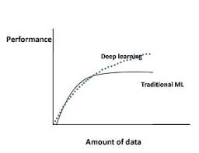
Need of data understanding
5. Quantity
Data should be sufficient to make successful machine learning model.
Ideal size of dataset depends upon
Complexity of algorithms
Predictive power of features
There is no thumb rule but many research papers suggest below guidelines:
Total number of data points must be more than 10 times number of features
For a simple ML algorithm each class should have minimum 100 data points
For a deep learning algorithm each class should have minimum 1000 data points

